Slide 1
Gambling Behavior Clustering
Vamshee Deepak Katta

Slide 2
Problem Statement
To divide customers into different segments based on their betting patterns in order to determine the bonus given to customers to encourage continuity.
The Dataset used for the project consists of betting data of 4150 customers from online gambling platform called Bustabit.
Data Source: Gambling Behavior Clustering | Kaggle

Slide 3
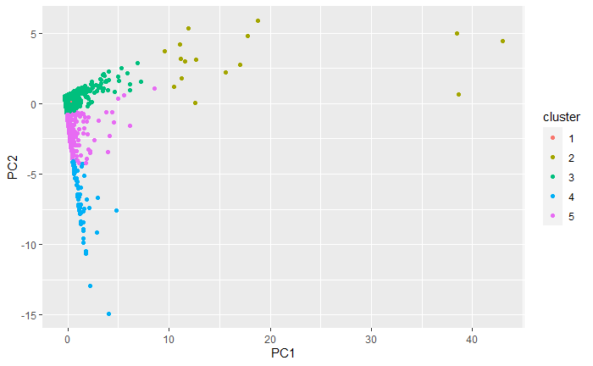
Approach
Using K-Means clustering algorithm to segment the customers into distinct clusters based on their betting patterns. The steps taken are as below:
Determining relevant variables for clustering.
Creating player-wise statistics from the current game-level statistics.
Normalizing the data and clustering the players using K-Means algorithm.
Computing averages for each cluster to determine the distinction of the clusters.
Visualizing the clusters with principle components.

Slide 4

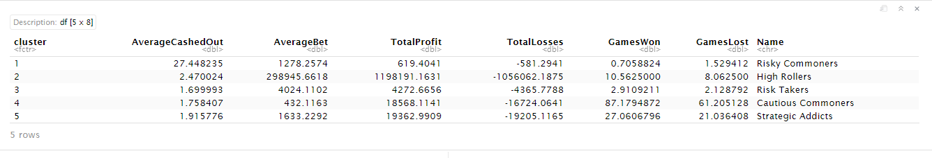
Conclusion
From the above approach, we can determine the clusters of customers and thus help determine the bonus given to customers to leverage continuity. Above is a snip of output upon successfully conducting clustering.
Cautious Commoners: This is the largest of the five clusters, and might be described as the more casual Bustabit players.
Strategic Addicts: These users play a lot of games on Bustabit, but tend to keep their bets under control.
Risky Commoners: These users seem to be a step above the Cautious Commoners in their Bustabit gambling habits, making larger average bets, and playing a larger number of games on the site.
Risk Takers: These users have played only a couple games on average, but their average cashed out value is significantly higher than the other clusters
High Rollers: High bets are the name of the game for this group.

